Slide 1
LENDING CLUB CASE STUDY
SUBMISSION
Group Assignment
Ashutosh Kulkarni
Kamal Mehta
Peeyush Singhal
Sayan Banerjee

Slide 2
Introduction and Purpose
Introduction: Lending Club is the largest online loan marketplace, facilitating personal loans, business loans, and financing of medical procedures. Like most other lending companies, lending loans to ‘risky’ applicants is the largest source of financial loss (called credit loss). Lending club is interested to understand the ‘risky’ applicants via the historical data to minimize its financial loss.
Purpose: The company wants to understand the driving factors (or driver variables) behind loan default, i.e. the variables which are strong indicators of default. The company can utilise this knowledge for its portfolio and risk assessment. The purpose of this Exploratory Data Analysis (EDA) is to understand
consumer attributes and
loan attributes
influence the tendency of default.

Slide 3
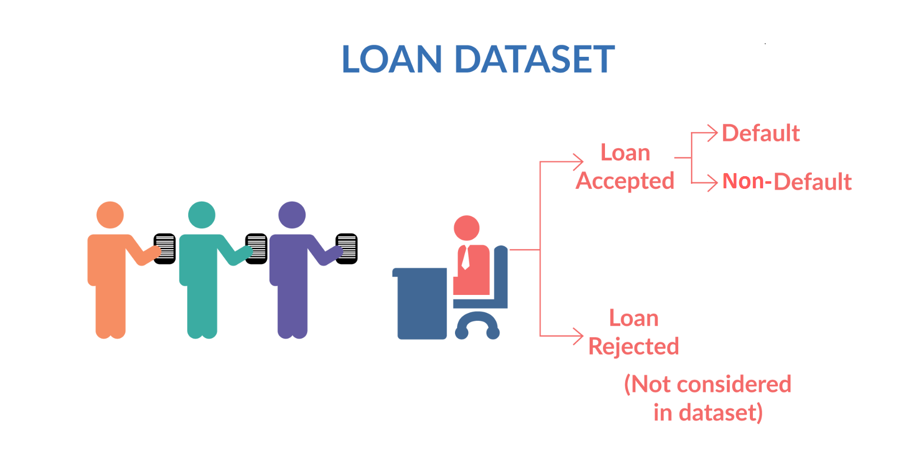
Data Understanding
Loan Variables
Pre-Loan Variables
Loan Variables (Company Intrinsic)
Post-Loan Variable
Included
Excluded
Excluded
These are customer profile variables which are available during loan application phase.
Some of these might indicate whether a customer is likely to default or not. These are the variables which we are going to identify and focus on during this EDA case study.
These are the variables which typically lender controls and can adjust based on the profile of loan applicant. These variables are loan amount (that is finally approved), interest rate, term and monthly repayment amount. It is clear from business understanding that these variables should not be considered as driver variables for default.
These are variables which are generated after the loan has been granted to loan applicant and when loan cycle has started.
These typically include payments, payments missed, payment due date etc. It is clear from business understanding that these variables should not be considered as driver variables for default as these cannot indicate the likelihood of default at loan application stage.
Loan Accepted – Non-Default (Fully Paid)
Included
Loan Accepted – Current**
Excluded
Loan Accepted – Default (Charged Off)
Included
**Loan Accepted – (loan_status=)Current, an intermediate state, is excluded from analysis because these customers do not participate to show propensity to default or non-default. The propensity can be understood only for completed loans

Slide 4
Data Cleaning and Manipulation
Sanity Check
Cleaning
Manipulation
Removing Rows
Finding percentage of missing values in each column
Imputation for missing values
Having 100% missing values or same values (zero standard deviation)
Loan status == Current **
Unique / Duplicate values in columns
Where every row has a different value
Cleaning
Leading & Lagging spaces
Converting String to Integer (example : months)
Remove signs (example % in interest rates)
Emp_length = NA
Revol_util = 0
mths_since_last_record = -1
pub_rec_bankruptcies = 0
Loan Variables and Post-Loan Variables **
Removing Columns
** see Data Understanding

Slide 5
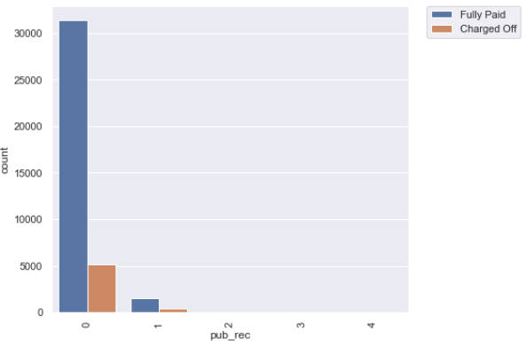
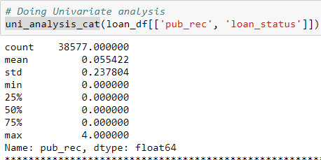
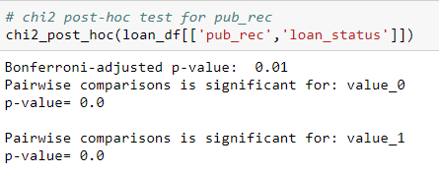
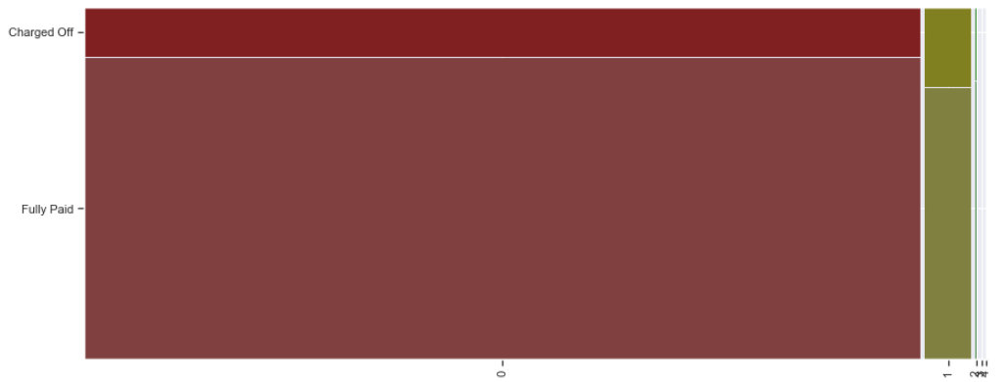
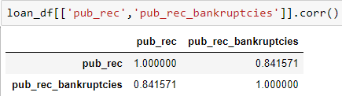
Data Analysis : Insight into establishing Impacting variables : Customer Variable – pub_rec/pub_rec_bankruptcies
Example
annual_inc
emp_length
pub_rec / pub_rec_bankruptcies
earliest_cr_line - charged off proportion increasing from 2004
pub_rec: Number of derogatory public records;
pub_rec_bankruptcies: Number of public record bankruptcies
These variables have got values like 0, 1, 2, 3, 4, so we have used categorical analysis here, though the values are numeric
Customer
2
Count plot
1
Univariate Analysis
4
χ² post-hoc test
pub_rec & pub_rec_bankruptcies are statistically significant when looked against loan_status
pub_rec and pub_rec_bankruptcies have got high correlation
3
Mosaic plot
5
Correlation analysis

Slide 6
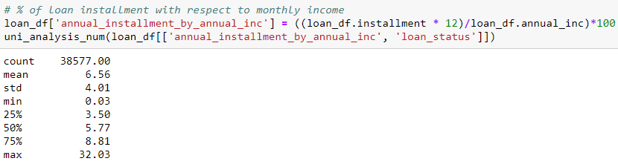
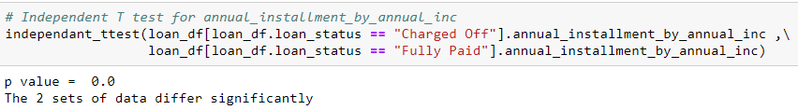
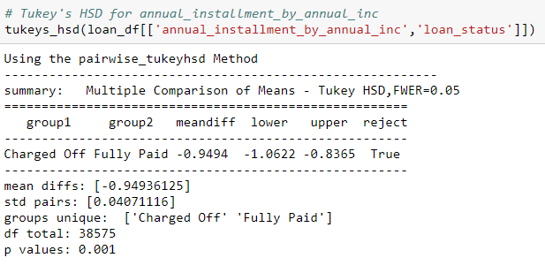
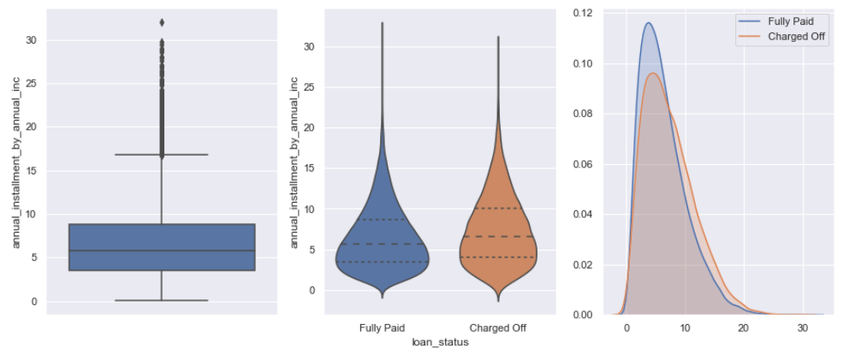
Data Analysis : Insight into establishing Impacting variables : Derived Variable – annual_installment over annual_income
Example
annual_installment as percent of annual_income
Derived
Univariate Analysis –quantitative
1
5
Independent t-test
3
Violin Plot
KDE plot
2
Box plot
4
6
Tukey HSD test
Rejection of null hyposthesis that annual_installment as a percentage of annual income does not have impact on sub categories of loan_status i.e charged off and fully paid

Slide 7
Conclusion
We believe the following variables impact the loan status (Charged off/Fully paid) the most
annual_inc
pub_rec / pub_rec_bankruptcies
term
revol_util
inq_last_6mths
annual_installment over annual_income
Customer
Loan
Derived
Annual_inc (Annual Income): Lesser annual income leads to more defaults.
Emp_length: Employment length in years : there is a possibility of default where the customer is not employed (‘NA’) or have experience >10 years
earliest_cr_line : The month the borrower's earliest reported credit line was opened : charged off proportion increasing from 2004
pub_rec: Number of derogatory public records: we found that if there is a record of derogatory public records present for a loan applicant that substantially increases the tendency for default.
Term: The number of payments on the loan: higher terms lead to more defaults.
purpose: purpose of loan: we found that some purposes for loan have a higher tendency for default like small business, renewable energy, education and others. Some of this might be due to risk associated with these ventures.
revol_util: Revolving line utilization rate, or the amount of credit the borrower is using relative to all available revolving credit: We found that there is an increase in tendency to default in case the revol_util increased
inq_last_6mths : The number of inquiries in past 6 months (excluding auto and mortgage inquiries) : The number of inquiries in past 6 months: we found that tendency to default increases as number of inquiries in past 6 months increases beyond 2, this suggests an evidence of 'credit seeking behavior' on part of loan applicant.
annual installment as a percent of annual income: This refers to the capacity of an individual to pay for the loan, we see that if the value when less gives rises to defaults
In such case we would suggest to increase the interest rate or lower the funded amount or reduce loan term.

Slide 8
Data Analysis : Most Impacting Variables
We believe the following variables impact the loan status (Charged off/Fully paid) the most
emp_length
earliest_cr_line - charged off proportion increasing from 2004
dti
purpose
annual_installment over annual_income
Customer
Loan
Derived
Additional Information:
verification_status - process related
issue_d - process related
Customer
Loan
Other Significant Variables
addr_state
dti
home_ownership
mths_since_last_record
total_acc
loan_amnt
installment
Loan amount over annual income
Surplus amount
Funded amount over loan amount
open_acc over total_vamp
Customer
Loan
Derived

